Slide 1
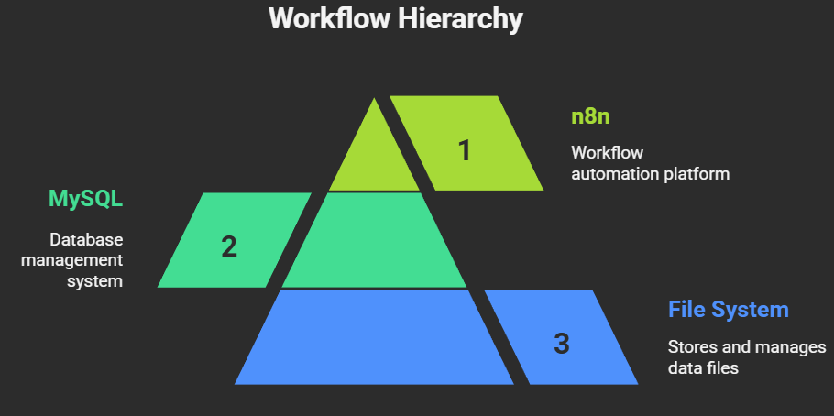

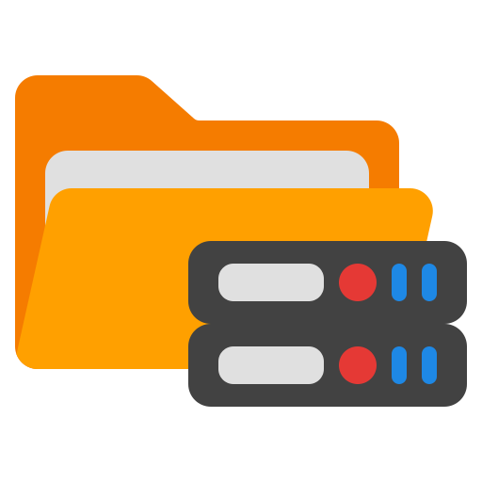
n8n Data Analyst AI Agent
Cricket Statistics Intelligence Platform

Slide 2
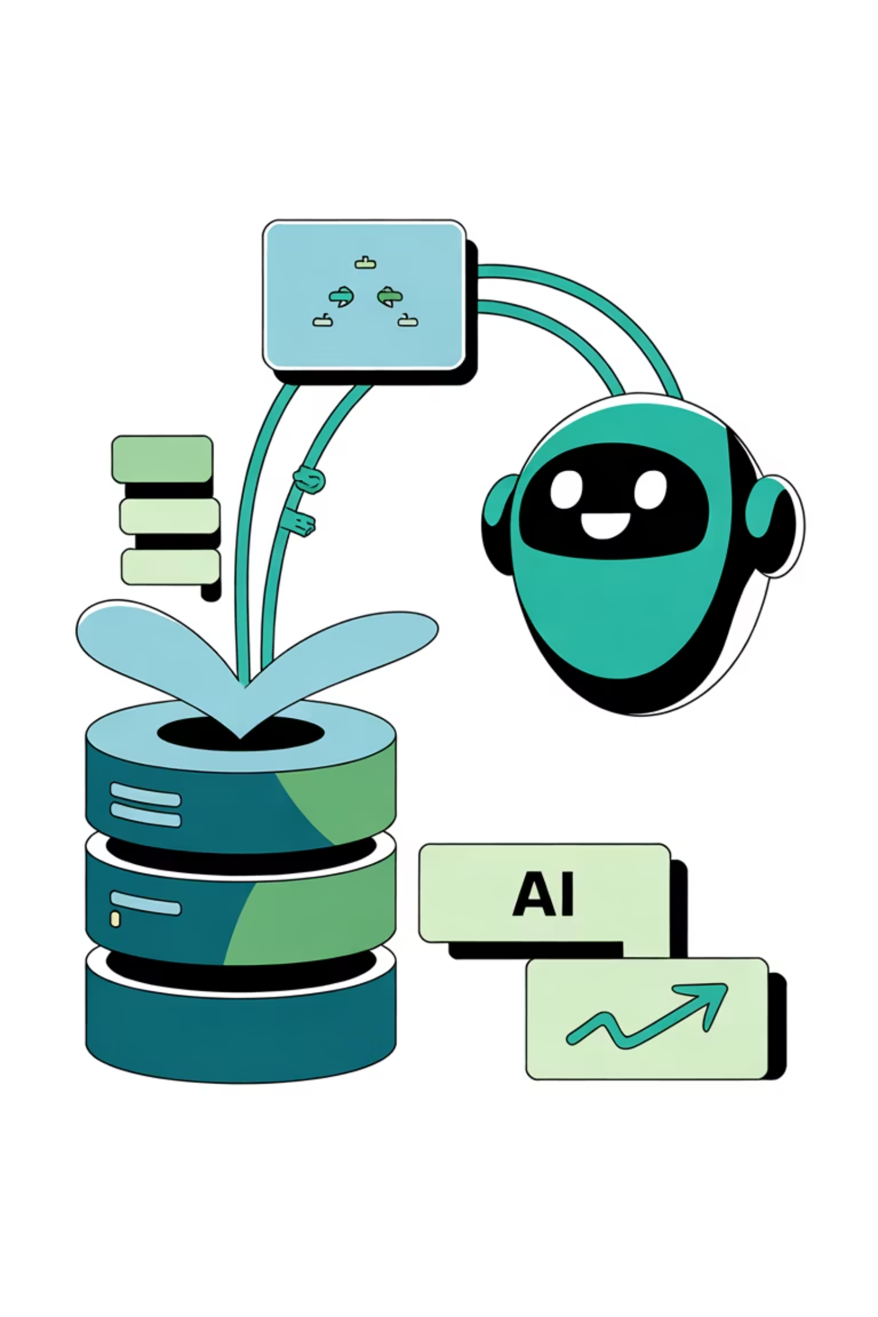
Workflow Overview
This intelligent workflow combines MySQL database queries, Google Gemini AI analysis, and Telegram notifications to deliver real-time cricket statistics insights. Users interact via a web-based chat interface that triggers automated data retrieval, AI-powered analysis, and persistent file storage—transforming raw database records into actionable intelligence.

Slide 3
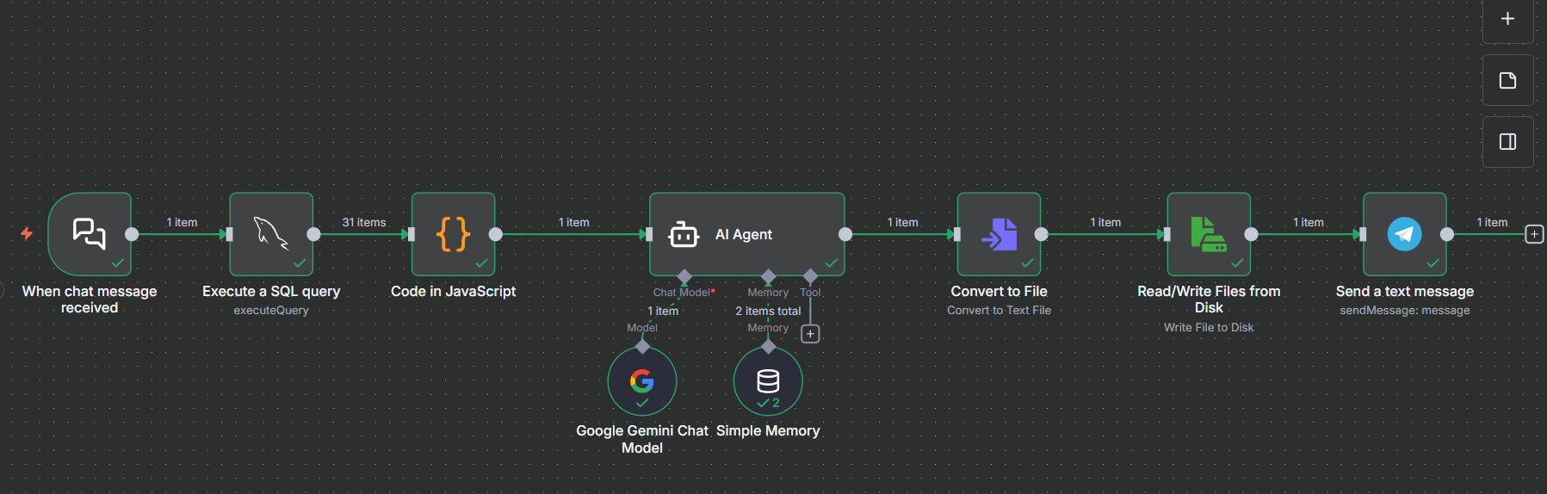

Slide 4
Core Architecture
Chat Interface
Data Layer
Web-based chat trigger providing user entry point and interactive conversation interface.
MySQL database connection retrieving cricket batsmen statistics with real-time data access.
AI Brain
Output Pipeline
Google Gemini LLM processing natural language queries and generating intelligent analytical insights.
File conversion, storage, and Telegram notifications ensuring results reach users reliably.

Slide 5
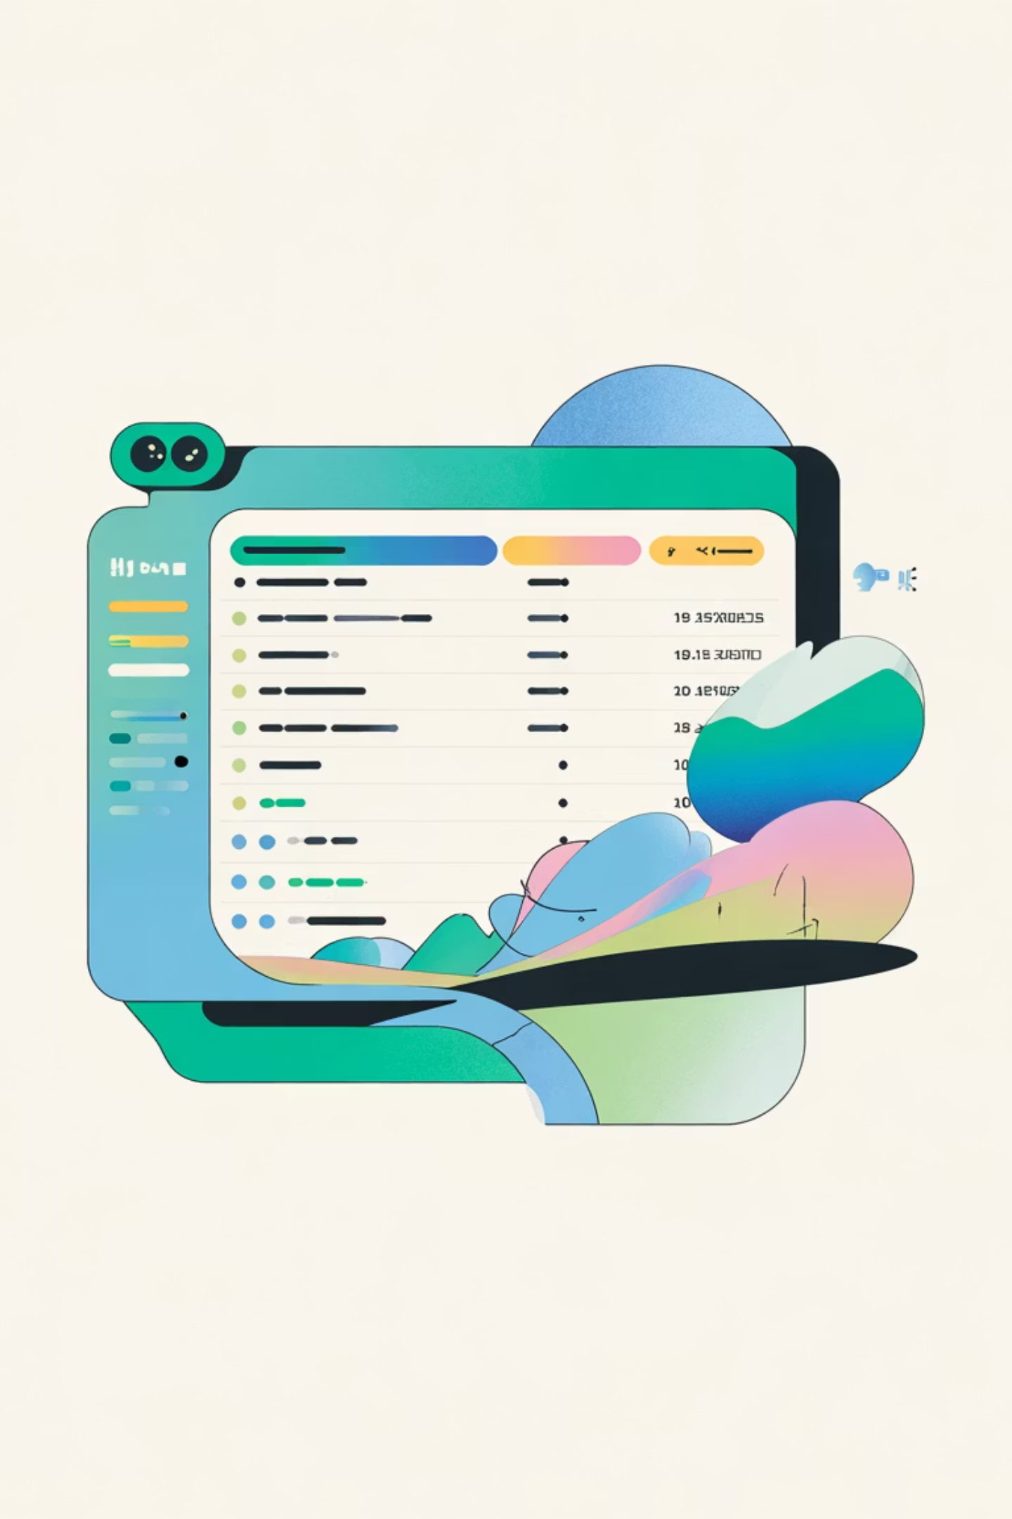
Component 1: Chat Trigger & Database Query
Chat Trigger Node
MySQL Query Node
Entry point creating a public web interface. Users see welcome message: "Hi there! 👋 I am a data analyst assistant how can I help u?" with input placeholder "Type your question.." This webhook-enabled component activates the entire workflow upon message submission.
Executes SELECT * FROM cricket_batsmen; retrieving player records including Batsmen name, Run_Score, Strike_Rate, Team, Opposition, and Venue. Direct database connection ensures real-time data availability for analysis.

Slide 6
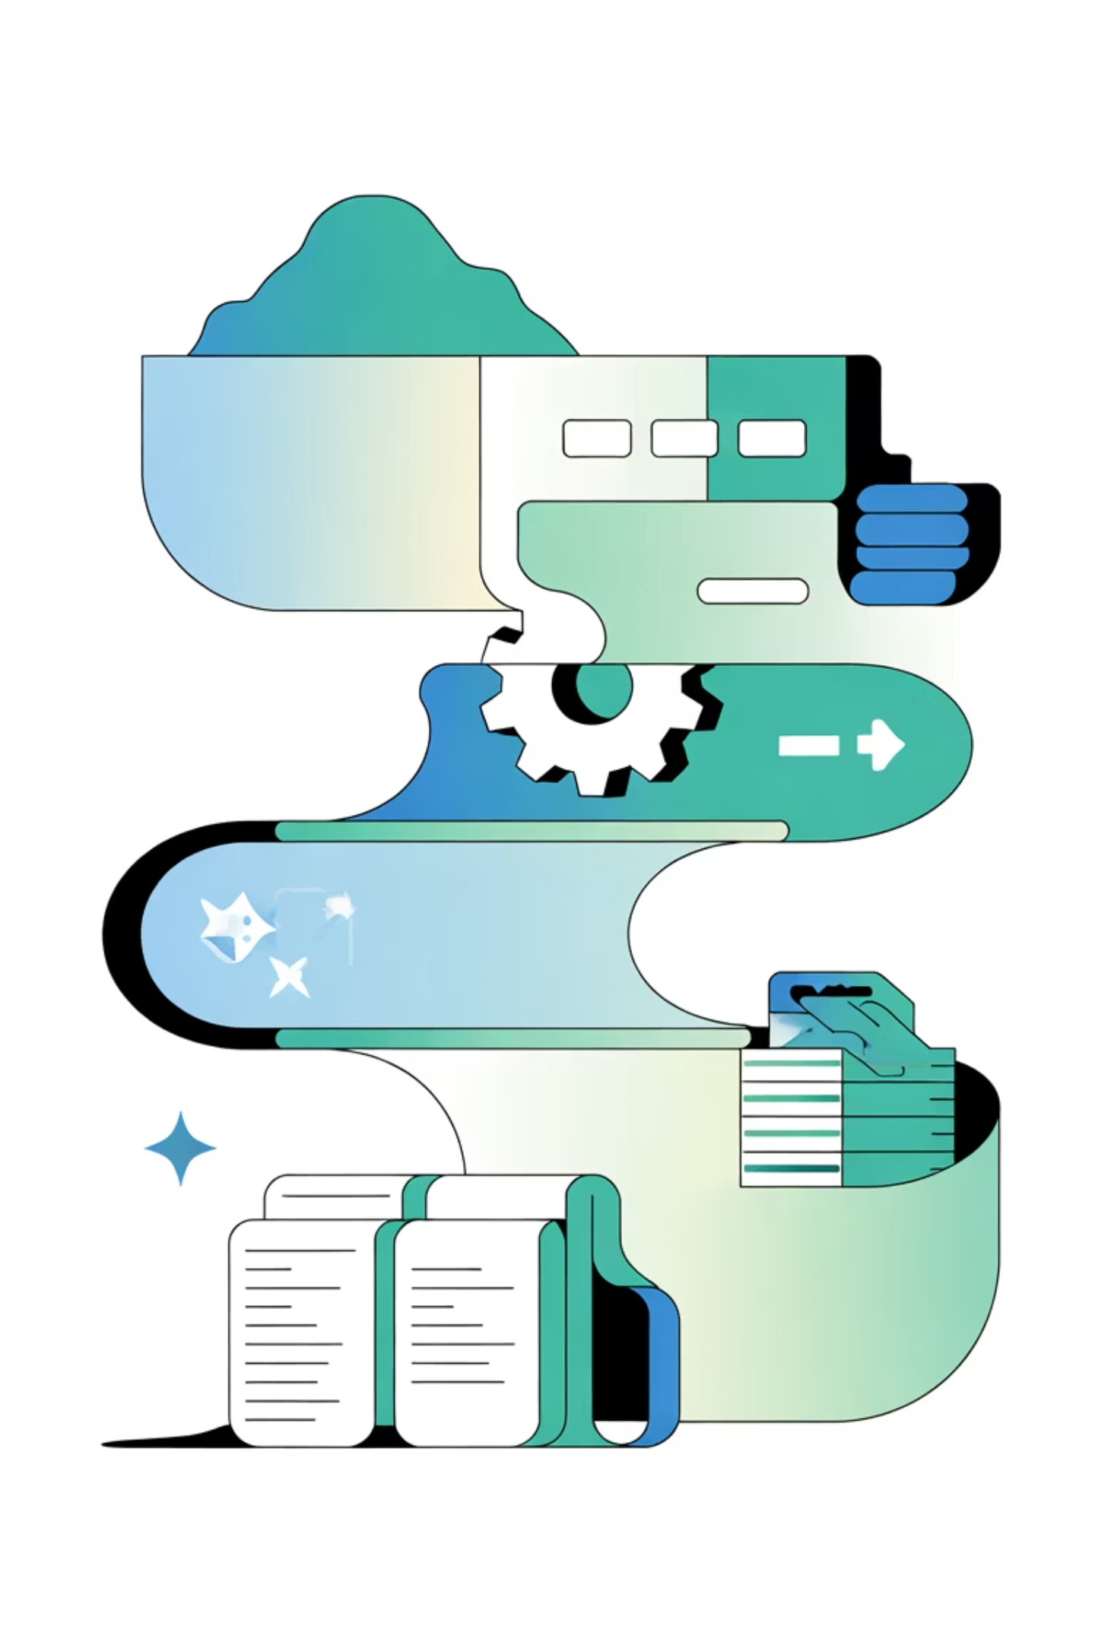

Component 2: Data Transformation
The JavaScript code node transforms raw SQL results into AI-readable format. It iterates through database records, converts each entry into human-readable sentences like: "Virat Kohli scored 127 runs with a strike rate of 95.3 for India vs Australia at Sydney." This formatted summary combined with analysis instructions creates the comprehensive prompt for AI processing.
Key Function: Constructs detailed analysis prompt requesting top 3 batsmen by strike rate with numerical comparisons and performance metrics.

Slide 7
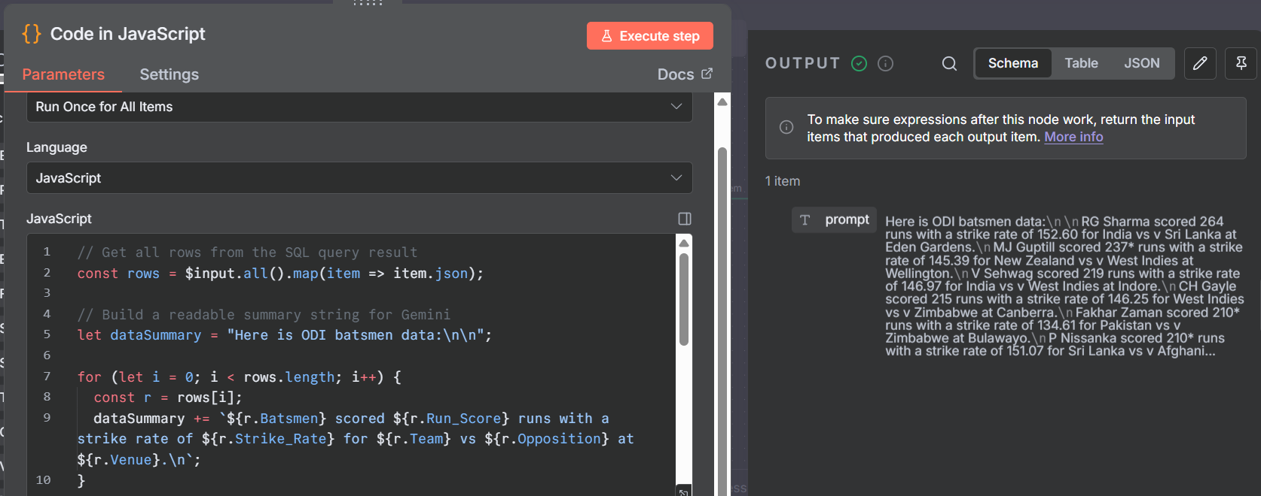

Slide 8




Component 3: AI Analysis Engine
n8n Data Orchestrator
Connects to MySQL , processes queries and automates data analysis .
Google Gemini LLM
Processes formatted data prompts and generates analytical insights using advanced language understanding.
Memory Buffer
Maintains conversation context with 15-message window enabling contextual follow-up questions.

Slide 9
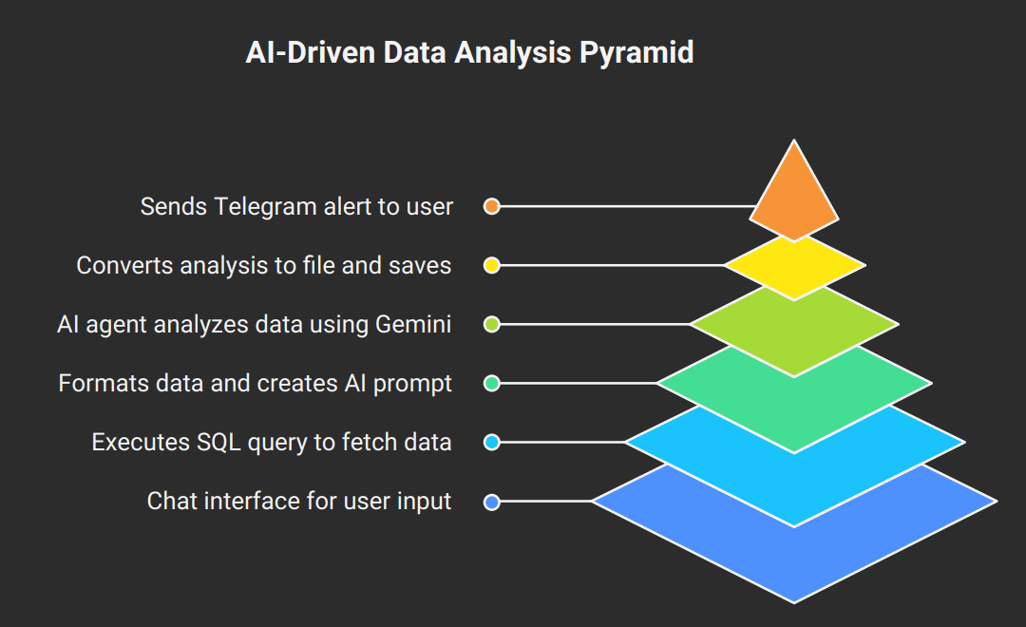
Data Flow & Execution Pipeline
User Initiates Chat
User opens webhook URL, receives welcome message, types cricket statistics question.
Database Retrieval
MySQL node executes query and retrieves all batsmen records from the database.
Data Transformation
JavaScript formats records into readable sentences and constructs analysis prompt.
AI Processing
LangChain Agent sends prompt to Gemini, which generates detailed comparative analysis.
File Creation & Notification
Analysis converts to file, saves to /home/node/files/ai_output.txt, and Telegram notification sent.

Slide 10





Key Features & Capabilities
AI-Powered Analysis
Conversation Memory
Real-Time Data Access
Google Gemini provides intelligent interpretation, comparative analysis, and performance insights from cricket statistics.
15-message context window enables the AI to remember previous questions and provide contextual follow-up responses.
Direct SQL execution retrieves live cricket batsmen statistics from MySQL database instantly.
Persistent Storage
Telegram Notifications
AI analysis saves to timestamped files on the server filesystem for audit trails and historical reference.
Instant alerts inform users when analysis completes and file is ready, enabling remote workflow monitoring.

Slide 11

Configuration & Requirements
Credentials Required
System Requirements
MySQL database (host, port, credentials)
n8n instance (self-hosted or cloud)
Google Gemini API key
File system access at /home/node/files/
Telegram bot token
Cricket batsmen table access
MySQL network connectivity
Internet for API calls

Slide 12
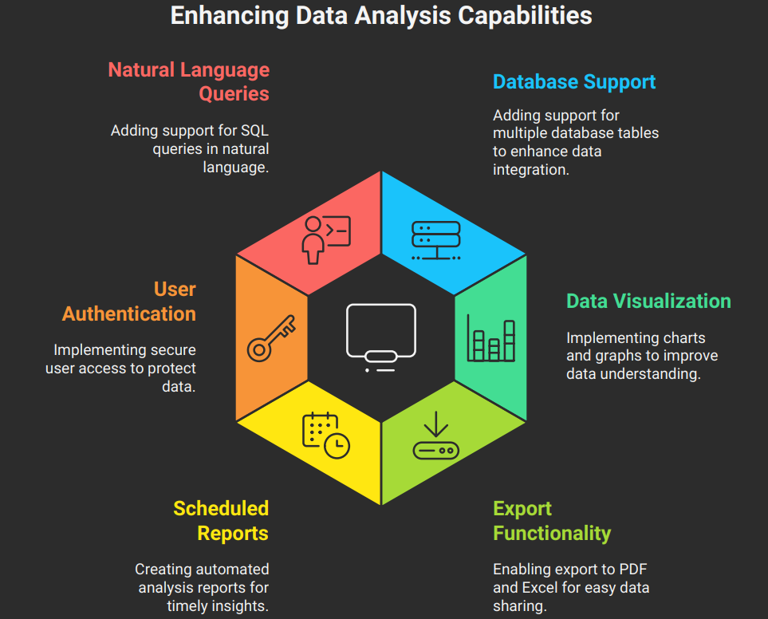
Future Enhancements & Conclusion

